Slide 1
ASP Net RESTFul Web API Core Security JWT

Slide 2
Topics
01 Installation
02 Methods: Get, Post, Put, Delete – the basic (wrong) way
03 Content Negotiation
04 Status Codes and IHttpActionResult
05 Methods: Get, Post, Put, Delete – the right way
06 Custom Method Names
07 Attribute Routing
08 Query String Parameters
09 FromUri and FromBody
10 Cross-Origin Resource Sharing (CORS)

Slide 3
Installation
יש צורך להתקין את 3 החבילות הבאות. נא לשים לב לגרסאות שמתאימות לגרסת ה .NET שלכם:
Microsoft.AspNetCore.Authentication.JwtBearer
Microsoft.IdentityModel.Tokens
System.IdentityModel.Tokens.Jwt

Slide 4
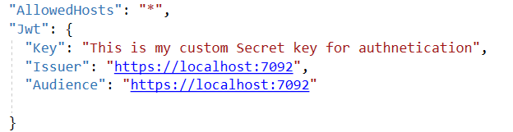
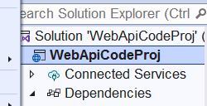

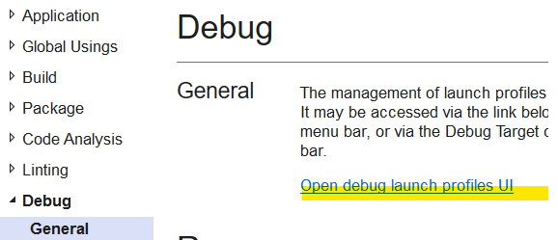
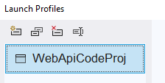

Set Up
Just a random key. For example from https://randomkeygen.com/
בקובץ appsettings.json

Slide 5
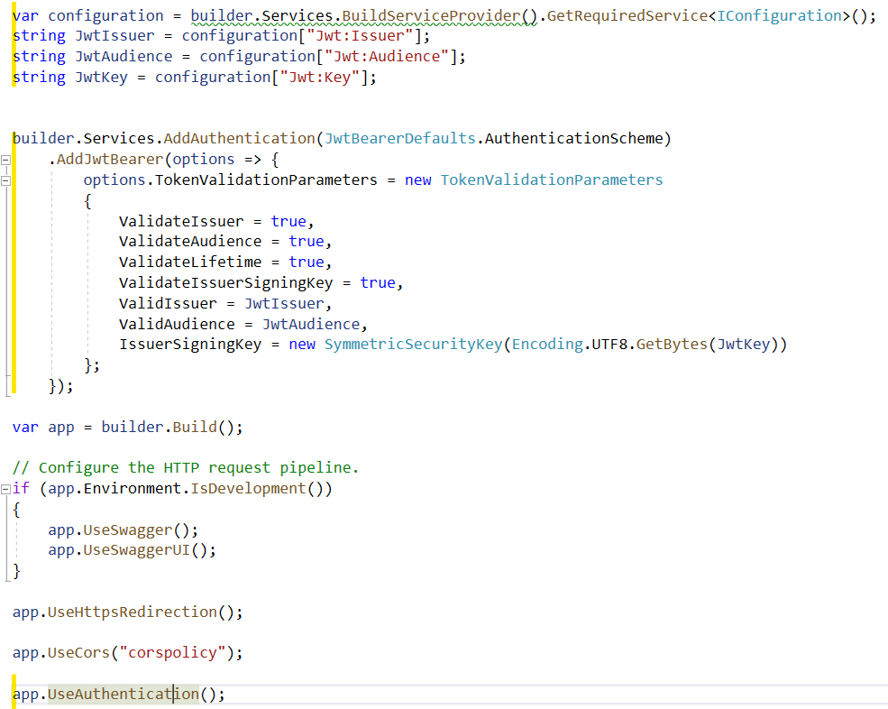
Set Up cont’
בקובץ Program.cs

Slide 6
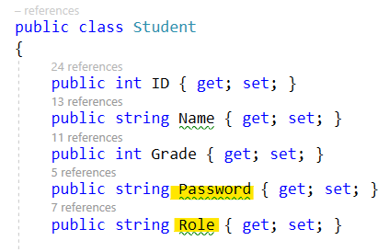
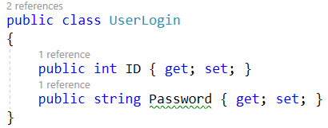
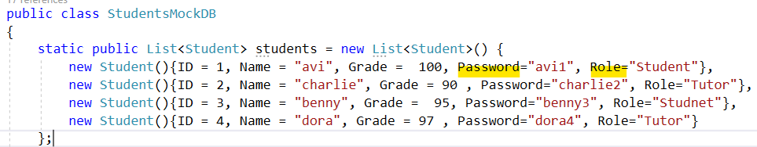
Model

Slide 7
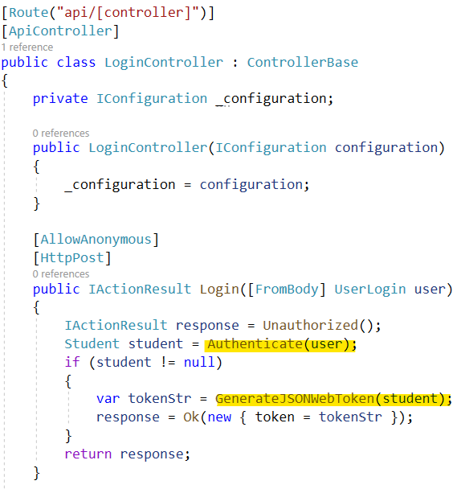
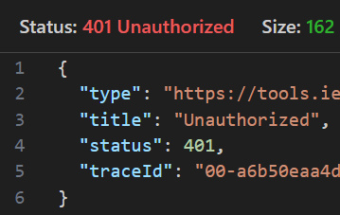
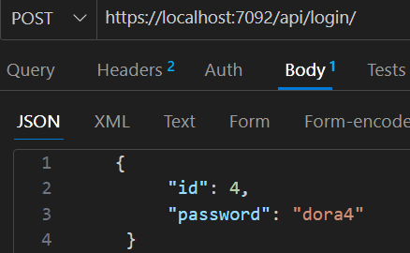
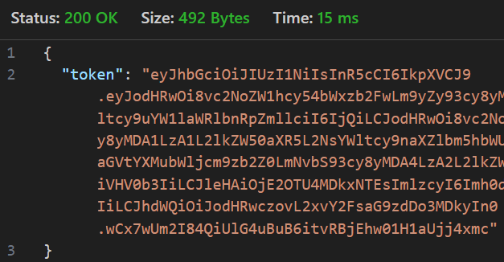
Login Controller – creating the JWT
Dependency injection
If login failed
Next page
Next page
Encripted data that is created in GenerateJSONWebToken function

Slide 8
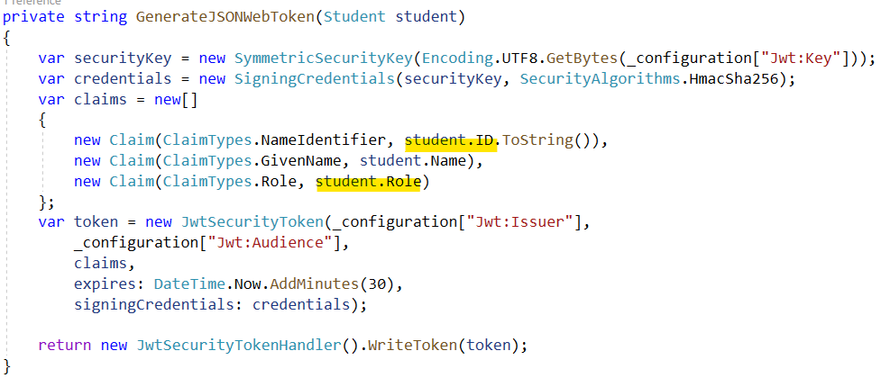
Login Controller cont’
The data that we need to hold in the JWT. This will be sent along with every request to the server. Encrypted.
Will be expired after this amount of time

Slide 9
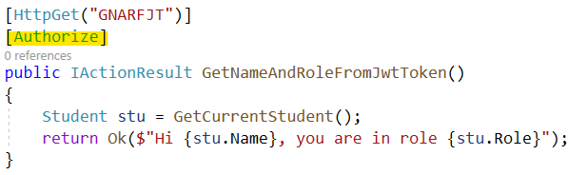

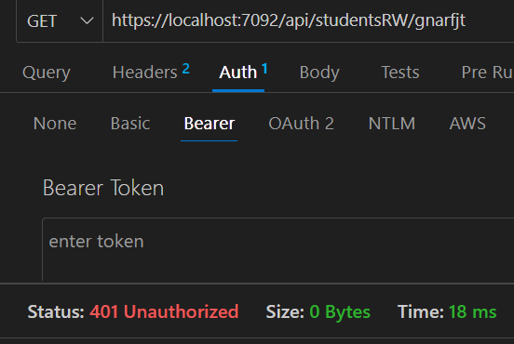
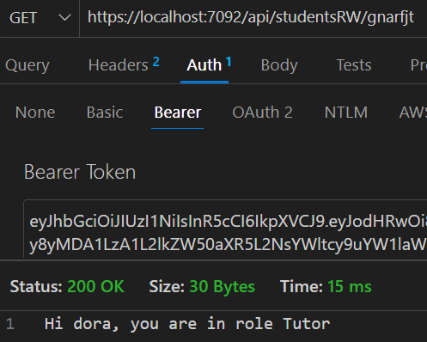

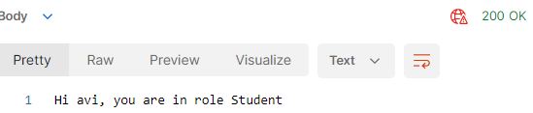
Students Controller – using the JWT
Only logged in students can call this method. Role doe not matter!
Next page…
If not logged in
Else send the token along with the request like this:

Slide 10
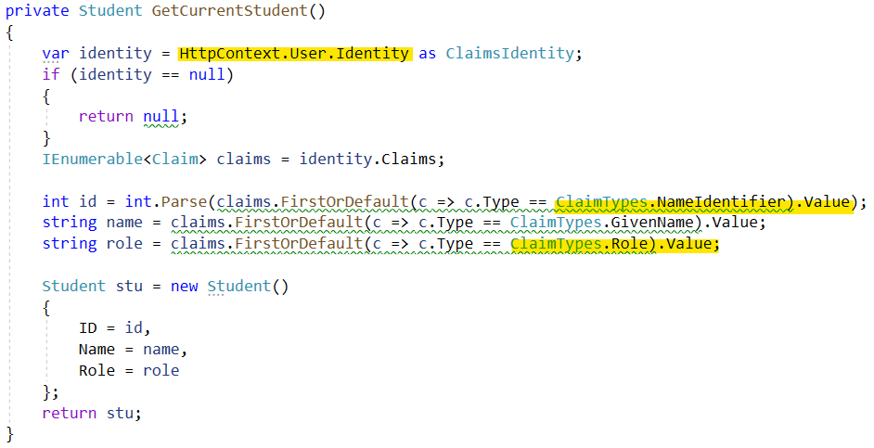
Students Controller – using the JWT
Get the data from JWT

Slide 11
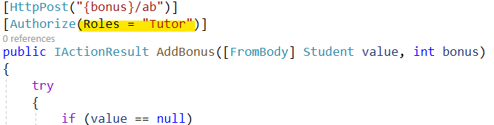
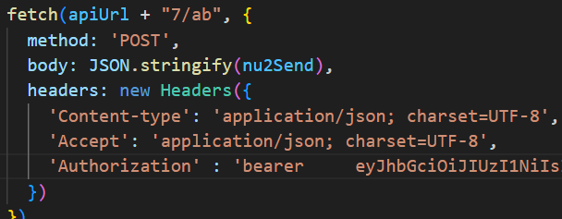
Students Controller – using the JWT
Only role Tutor can access this action
Student role will get
Tutor role will get
Without authorization header will get

